Slide 1

Gram Panchayat Digital Service Portal
Digitizing Rural Governance
Presented by: Debadrita Paul

Slide 2

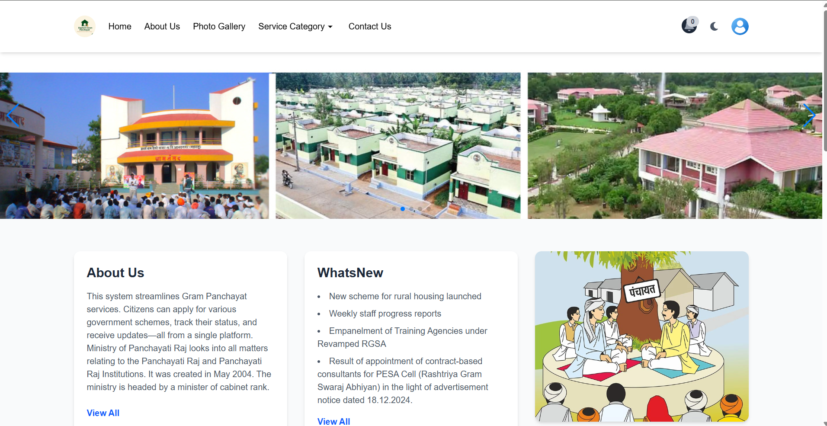
Introduction
This is a modern, user-friendly web application that streamlines services offered by the Gram Panchayat. The portal supports multiple roles (Admin, Officer, Staff, User), provides real-time notifications, form-based services, gallery, feedback systems, multilingual interface, and full responsiveness for mobile, tablet, and desktop screens.

Slide 3

Objective
Main goals of the system:
Modernize village administration
Increase transparency and efficiency
Digitally empower citizens

Slide 4
Key Features
Modules offered by the system:
Resident Profile Management
Document Upload & ID Verification
Online Grievance Registration
Certificate Requests & Approvals

Slide 5

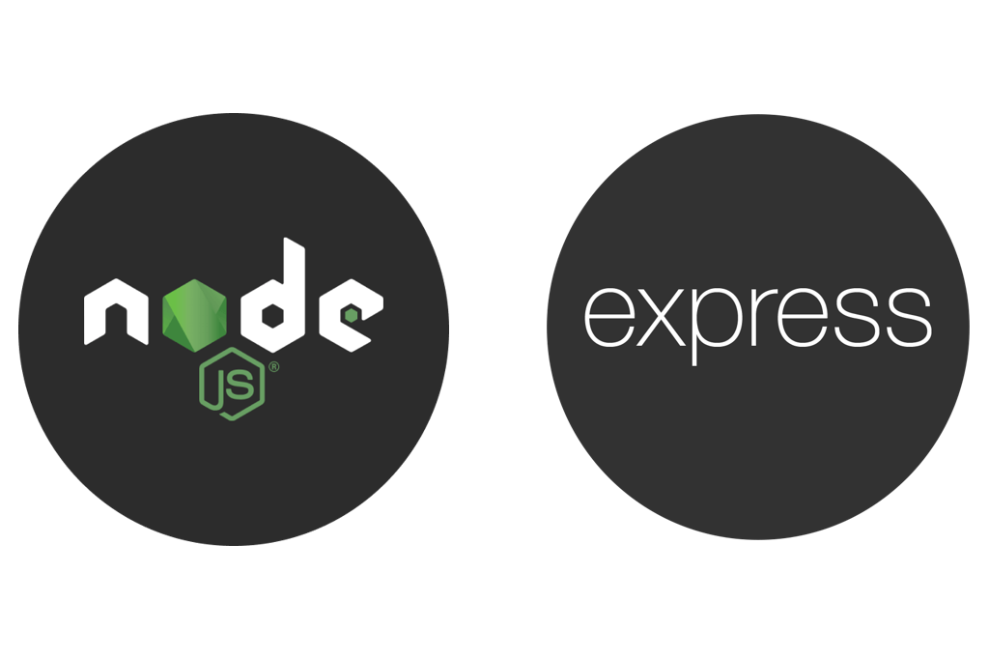

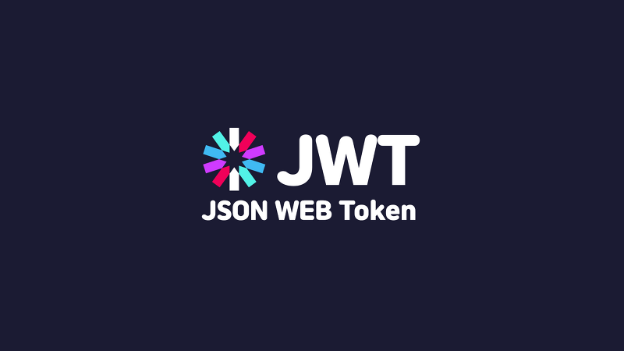
System Architecture
Technology stack used:
Frontend:
Backend:
Database:

Slide 6
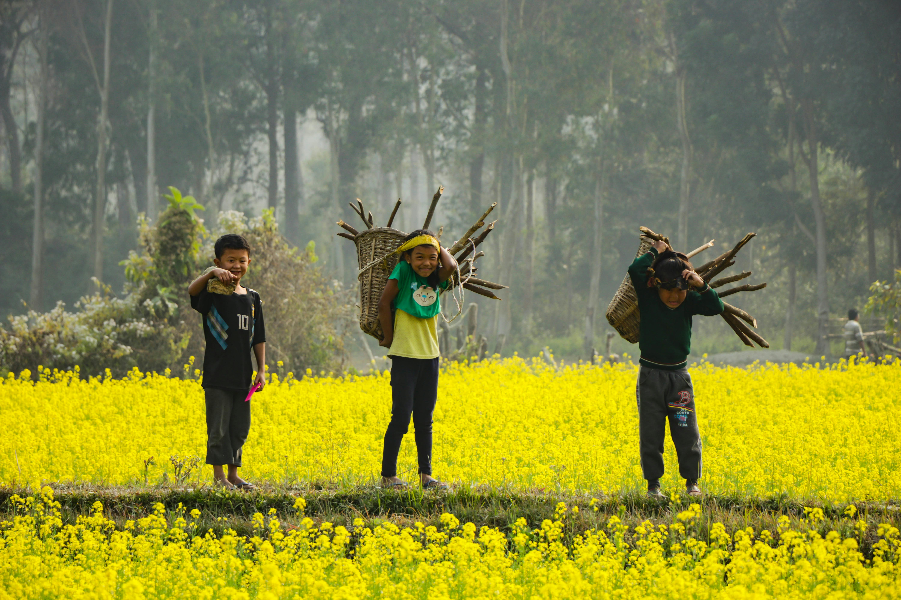
Backend Tech Stack
MongoDB Models:
Users
Applications
Services
Categories
Gallery
Feedback
Partners
Notifications
Contact Used for secure, scalable data storage.

Slide 7

Backend Tools
Node.js + Express
MongoDB (Mongoose Models)
JWT Auth + OTP Flow
Multer for file/image upload

Slide 8
Frontend Stack & Dependencies
Built using React and Tailwind CSS, the frontend leverages:
react-router-dom for routing,
tiptap for rich text editing,
swiper and slick-carousel for sliders,
axios for API communication,
react-toastify for alerts,
flowbite and heroicons for UI components.

Slide 9
Content Overview
Admin - Pages 11–19
Covers all admin functionalities, including managing categories, dynamic forms, services, applications, gallery images, partner logos, user accounts, and contact or feedback forms.
01.
Officer – Page 20
Explains officer access to add or modify services, update application statuses, and maintain contribution logs with limited admin privileges.
02.
Staff – Page 21
Describes staff capabilities in updating the status of assigned applications to Accepted, Rejected, or Pending, with all actions tracked for accountability.
03.
User – Pages 22–36
Details user features like secure registration with OTP, profile updates, browsing and applying for services through dynamic forms, tracking application statuses, viewing rejection reasons, exploring categorized galleries, submitting feedback with captcha, accessing static informational pages, and receiving animated notifications for status updates.
04.

Slide 10
User Roles
Different types of users in the system:
Admin (Panchayat Officers)
Resident (Users)
Staff (Block-level staff)

Slide 11

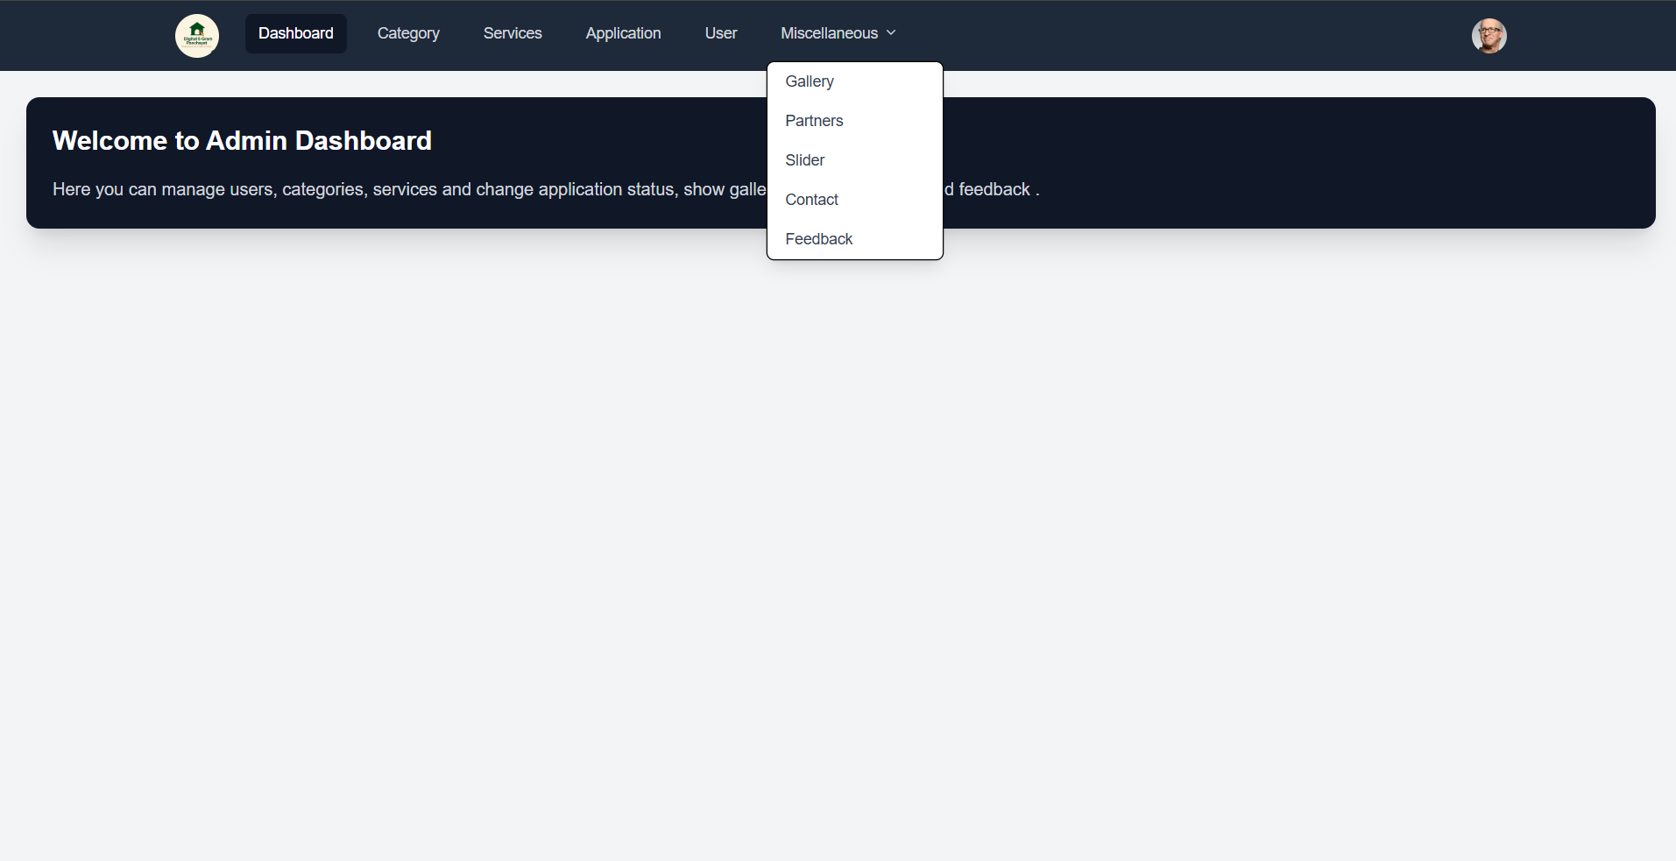
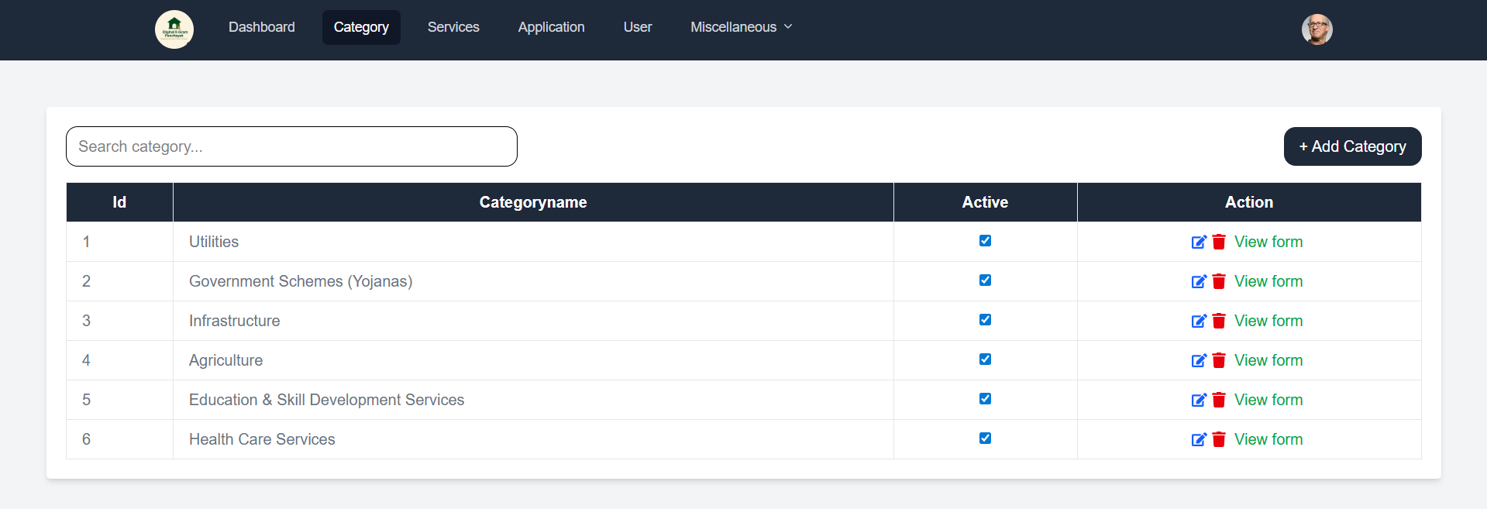
Admin Role - Category Management
Admin has full control over service categories:
Categories act as the base classification for services, such as 'Birth Certificate', 'Land Services', or 'Welfare Schemes'.
Add new categories relevant to government services.
Edit existing categories to update names or relevance.
Toggle Active/Inactive status for display control.
Delete outdated or incorrect categories.

Slide 12
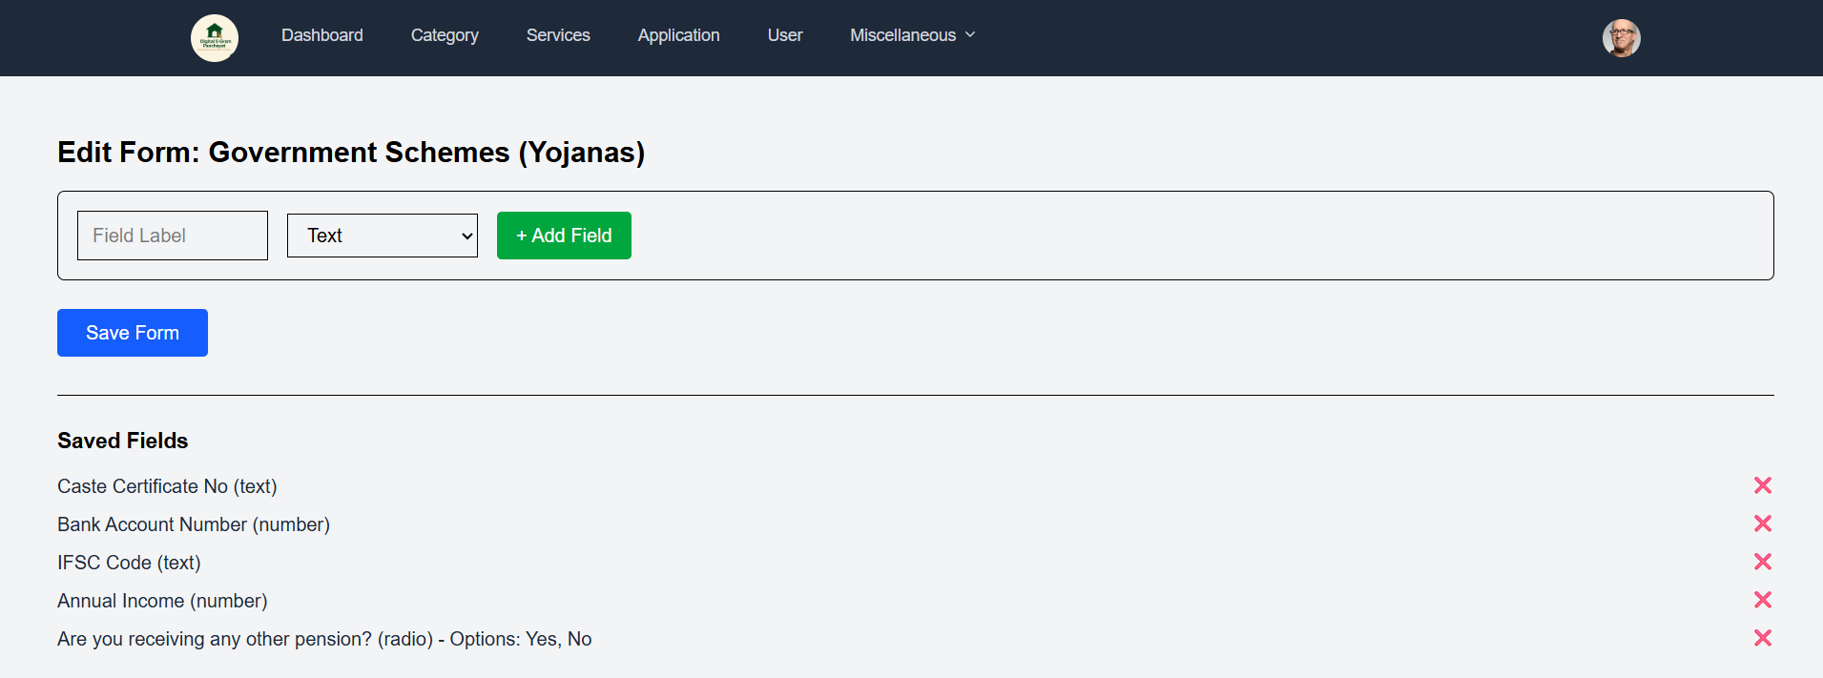
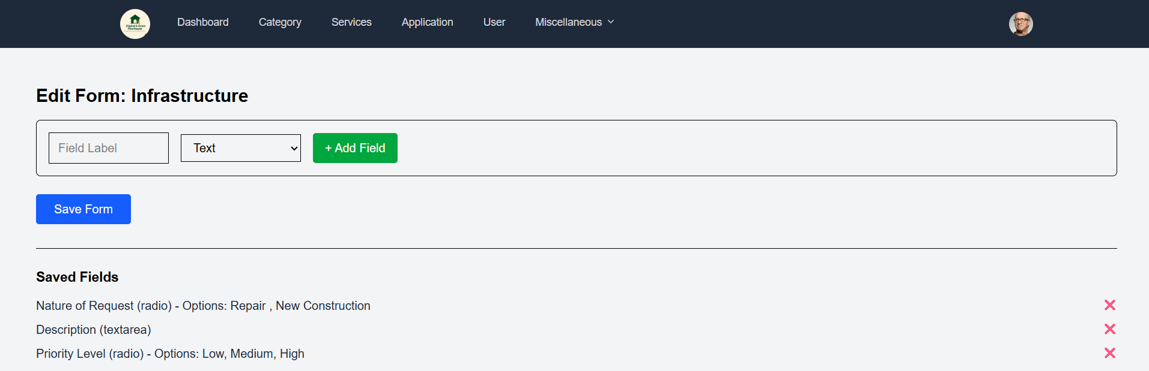
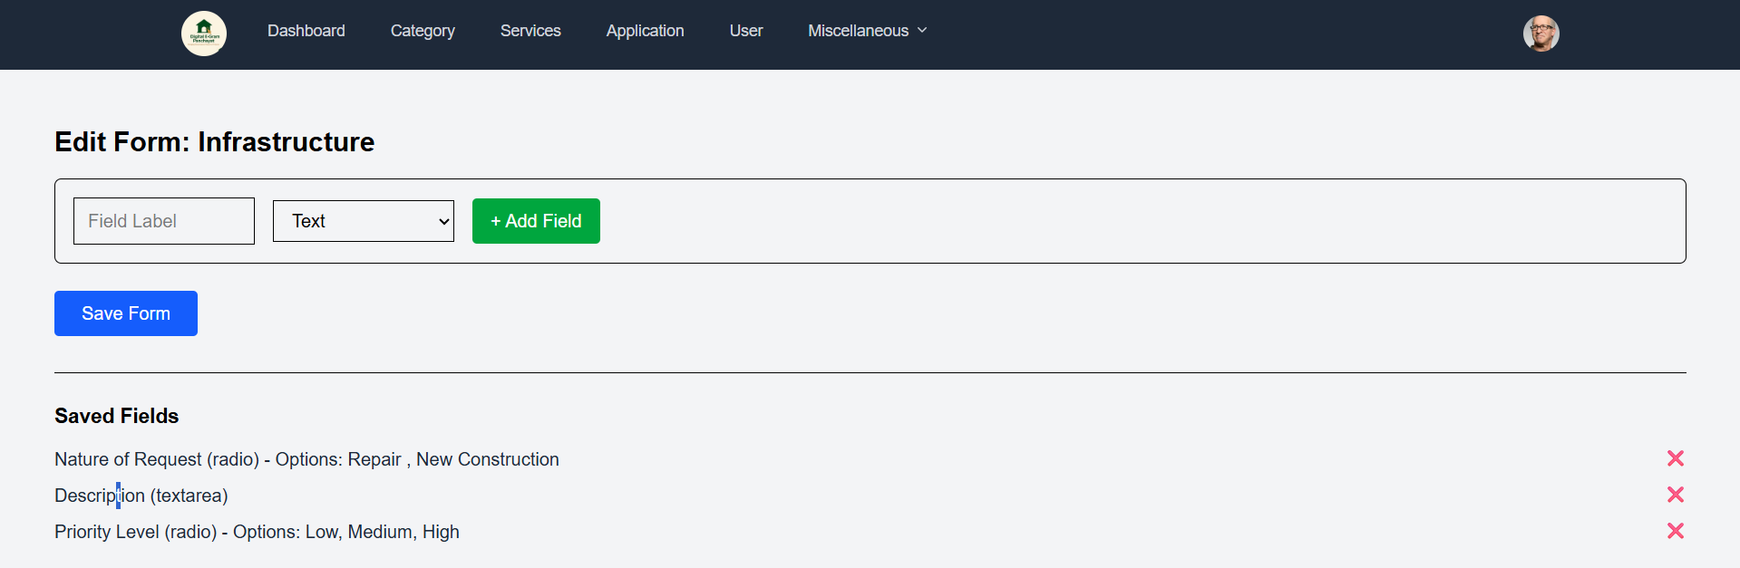
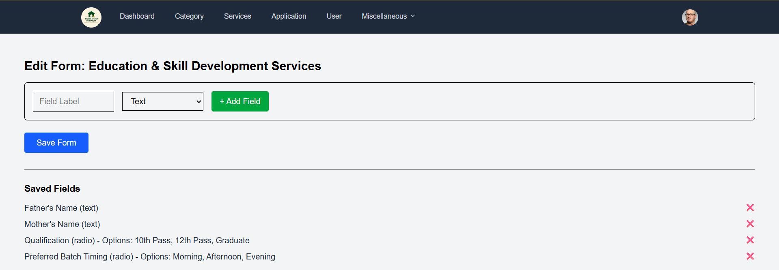
Admin Role - Form Management
Admin can:
Add dynamic forms under any category.
Edit form content such as questions, fields, types.
Delete obsolete forms field.
Ensure all services have well-structured forms users must fill while applying.

Slide 13
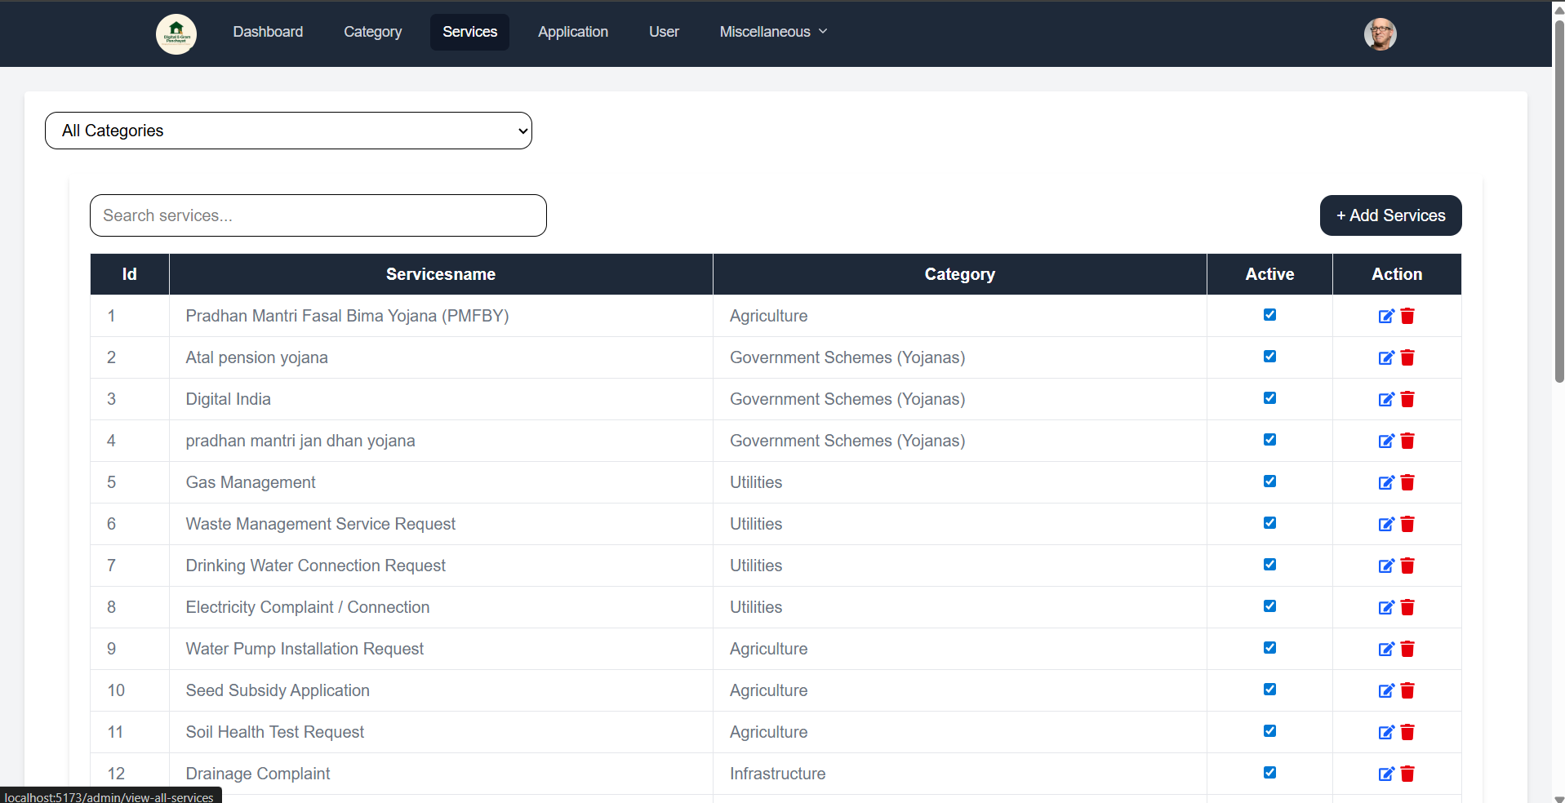
Admin Role - Service Management
Admin can manage services by:
Providing : a service name, an image URL for visual representation, a linked category for grouping, and a service description.
Selecting a main category for classification.
Updating status (active/inactive) as per availability.
Delete outdated services.

Slide 14
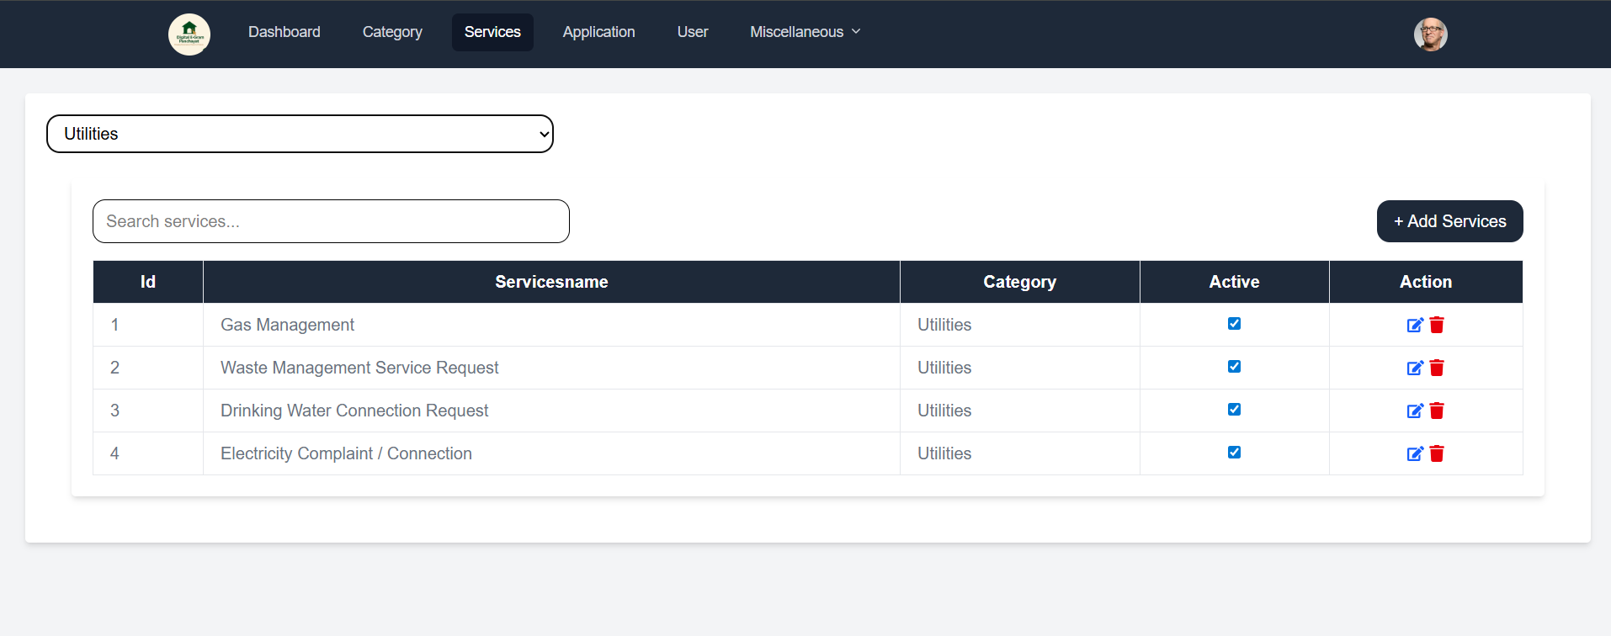
Admin Role - Viewing Categorized Services
Admin can view services organized by category:
Allows better overview of available services.
To manage services effectively, admins are provided with a categorized view. This helps in tracking which services belong under which category, whether any are inactive, and how many applications are received per category.

Slide 15
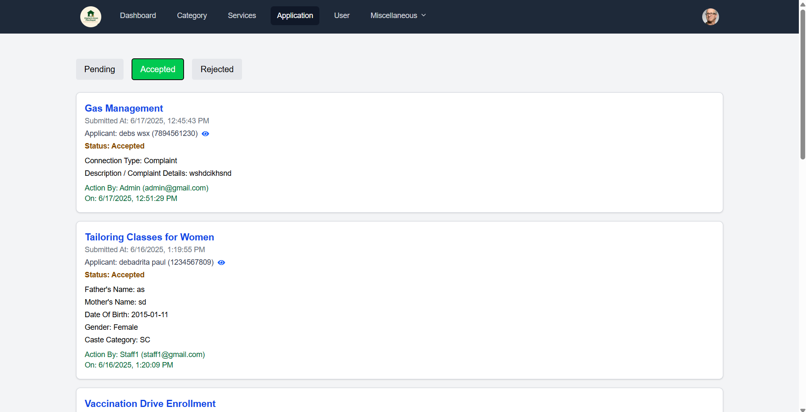
Admin Role - Application Oversight
Admin can:
View all user applications.
Filter applications by category or service.
Monitor submission dates and user details.
Take actions on any application (Accept/Reject/Modify).
This oversight helps the admin to monitor usage trends, identify misuse, or intervene when necessary.

Slide 16
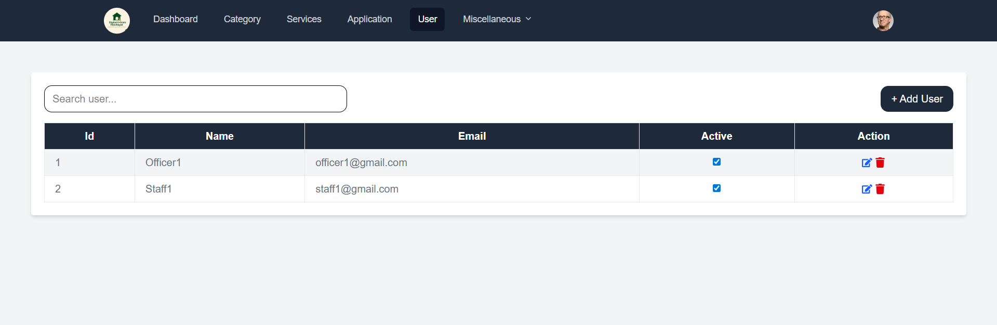
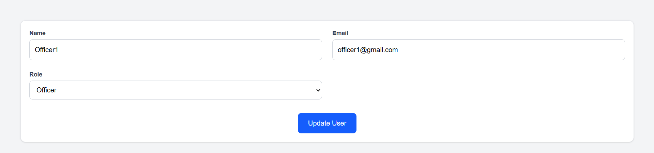
Admin Role - User Management
Admin has full control over users:
Add new staff or officers.
Edit user profile info or roles.
Toggle account activation.
Remove users when needed.
delete accounts permanently
This function is critical to maintaining system integrity and preventing unauthorized access. Additionally, user name help in searching staff and officers.

Slide 17
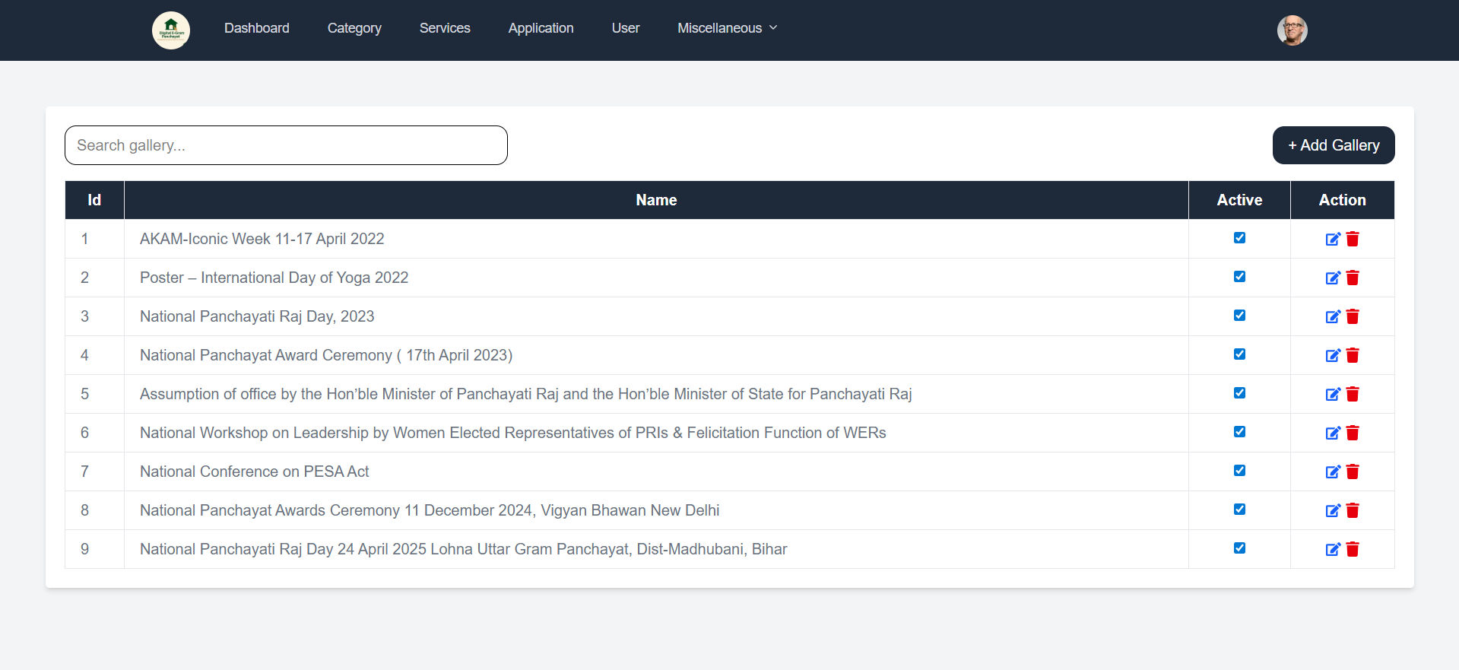
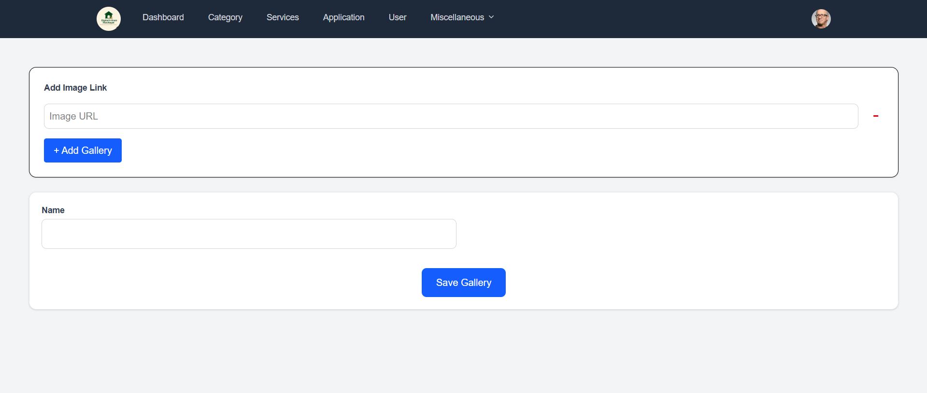
Admin Role - Gallery Management
Admin can:
The portal includes a gallery feature where admins can upload and manage photos under specific gallery names. Each gallery may represent an event or initiative, like “Swachh Bharat Drive 2024”. Admins can upload multiple image URLs to a gallery, edit gallery titles, or delete individual images. This helps document the Panchayat's work visually and makes the website more engaging.

Slide 18
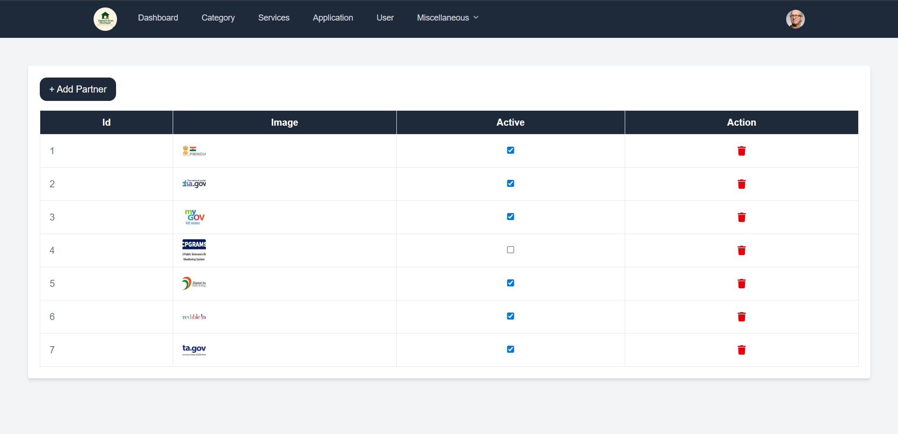
Admin Role - Partner Image Management
Admin can:
Upload partner logos or images for partners, sponsors, or collaborating agencies.
Delete outdated or irrelevant partner content.
Display them in the frontend banner or section.
These images can be added with links to their respective websites or just displayed in the “Our Partners” section

Slide 19
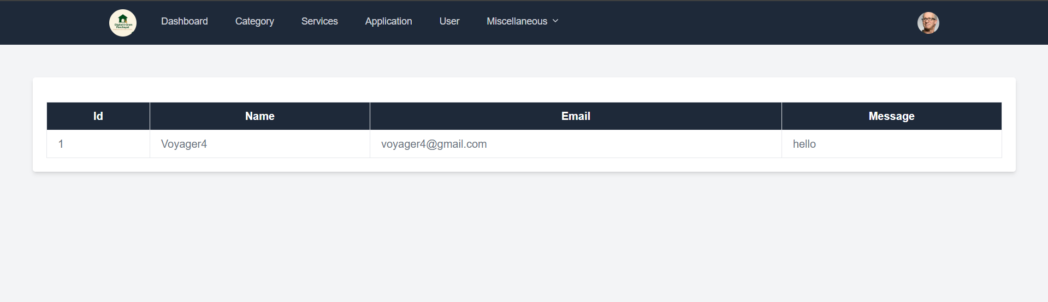
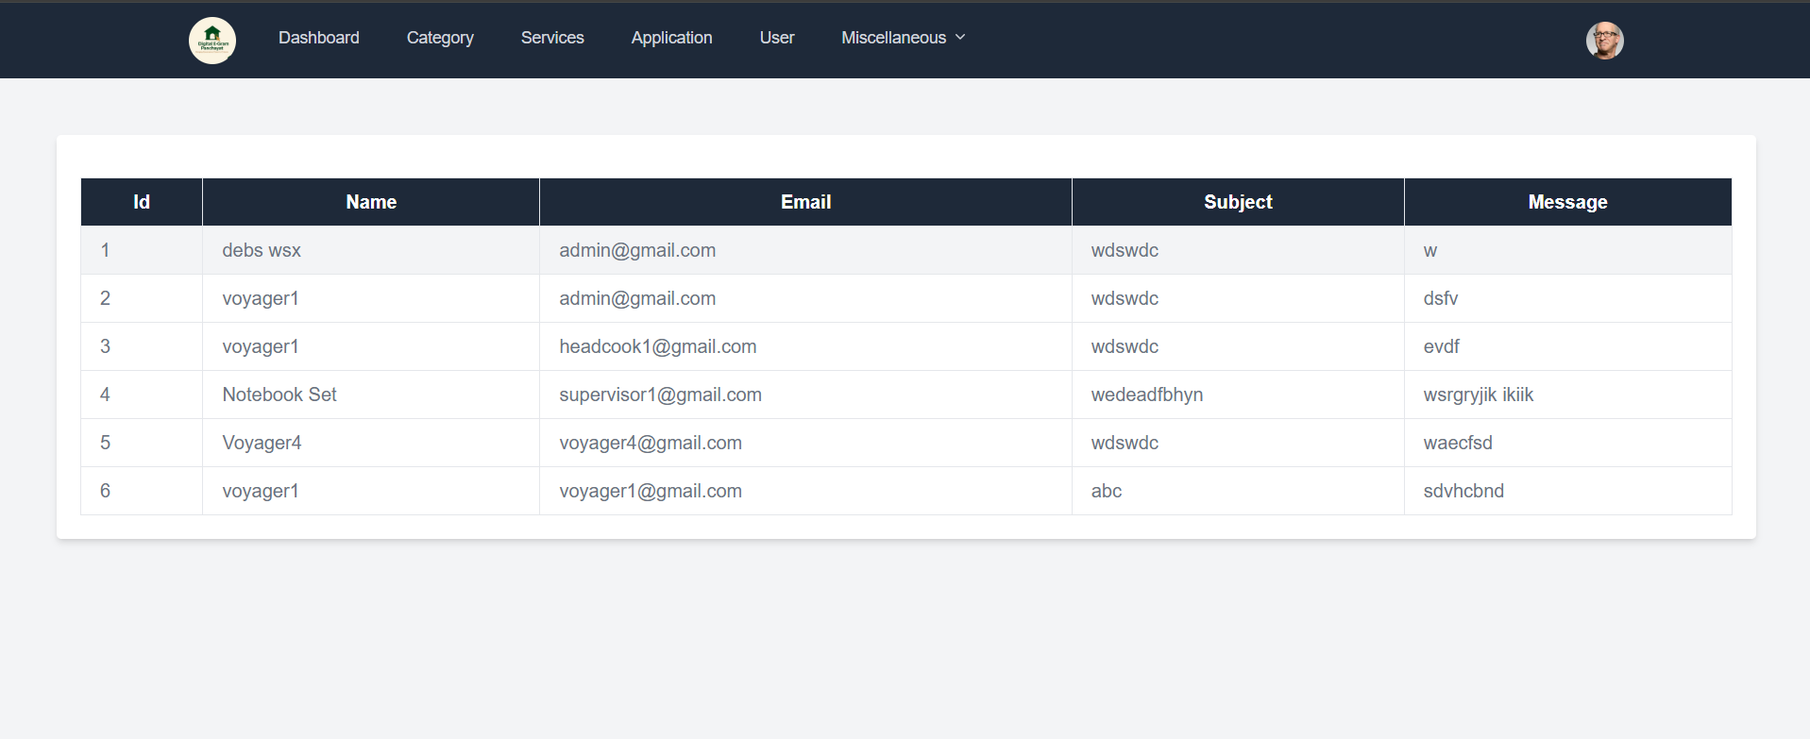
Admin Role - Viewing Contact and Feedback Forms
Admin can access:
Every time a user submits a contact or feedback form, the admin receives that data in the backend.
Admins can review messages, prioritize responses, and export feedback for quality analysis.
This centralized control enables better communication between the Panchayat and the citizens it serves.

Slide 20
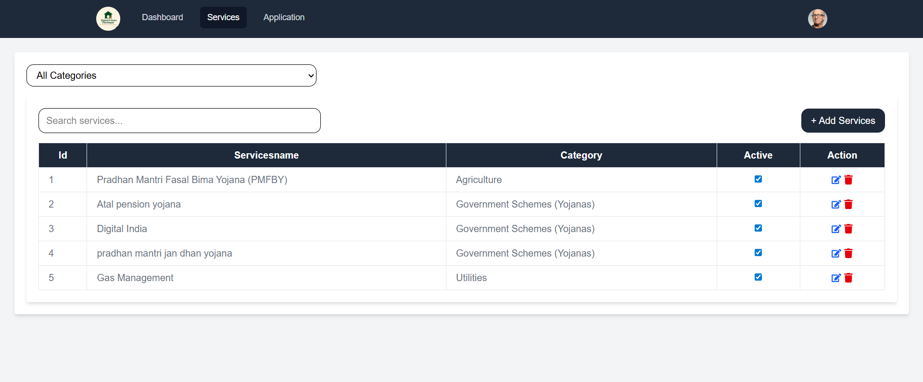
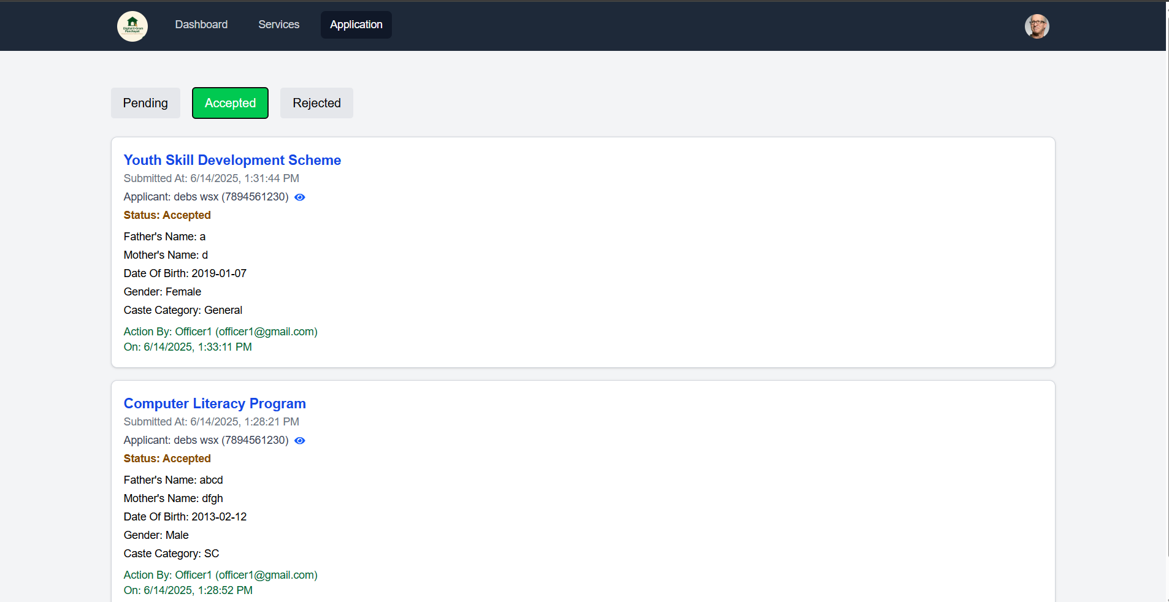
Officer Role - Service Management
Officers hold limited administrative access:
Add new services just like Admins.
Modify service details and ensure user needs are covered.
Change the status of applications (Accept, Reject, Pending).
Maintain their contribution logs with metadata.

Slide 21
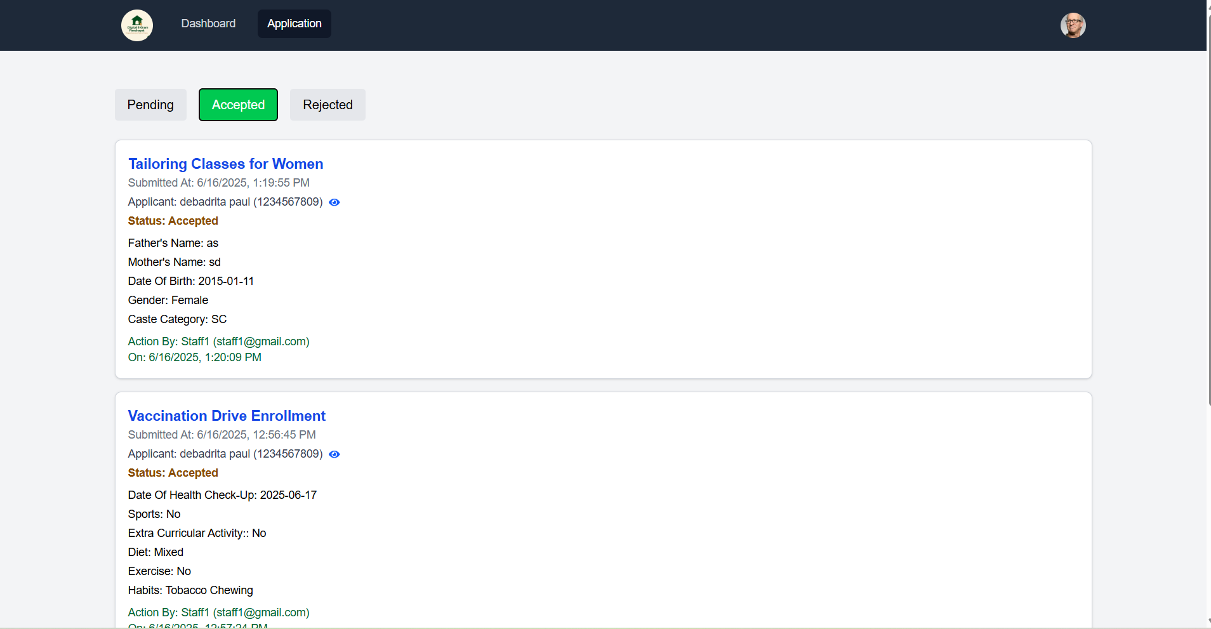
Staff Role - Application Status Updates
Staff can:
Only update status of applications assigned to them marking it as “Accepted”, “Rejected”, or “Pending”.
Cannot add new services or change statuses for applications they are personally responsible for.
Their actions are tracked by admin.
This separation of privileges ensures accountability and avoids unauthorized actions.

Slide 22
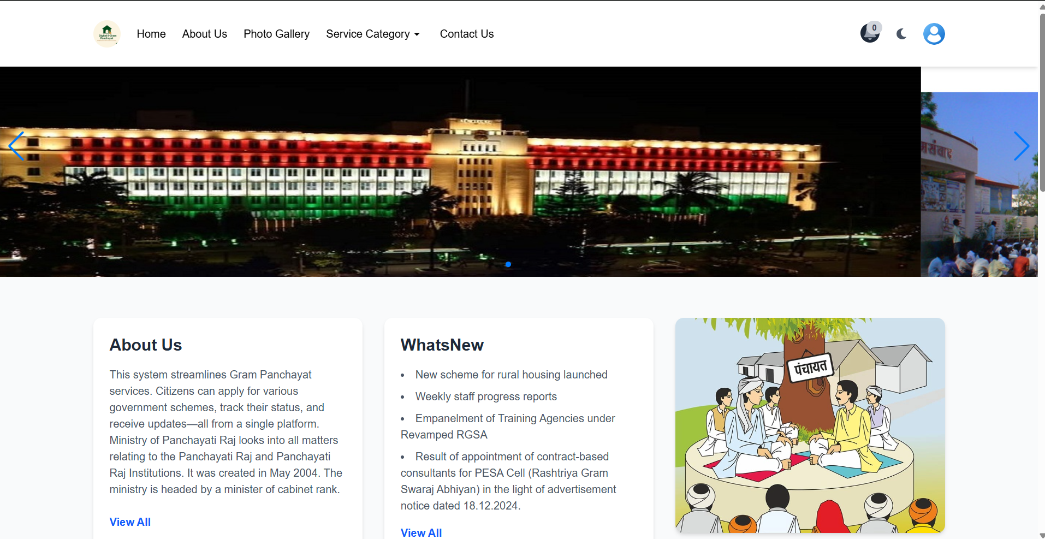
User Interface - Banner Slider
The homepage of the platform includes a dynamic slider section that can be updated with government announcements, event images, or new scheme banners.
This helps in user engagement and awareness.
Admins can control what images appear and how often they rotate, enhancing the user’s first impression.

Slide 23
User - Browsing and Applying for Services
Users can:
explore all available services under their respective categories.
Each service shows a title, description, and application button.
When applying, users fill in the dynamic form designed by admins.
Once submitted, the data is stored securely, and users can track its status anytime.

Slide 24
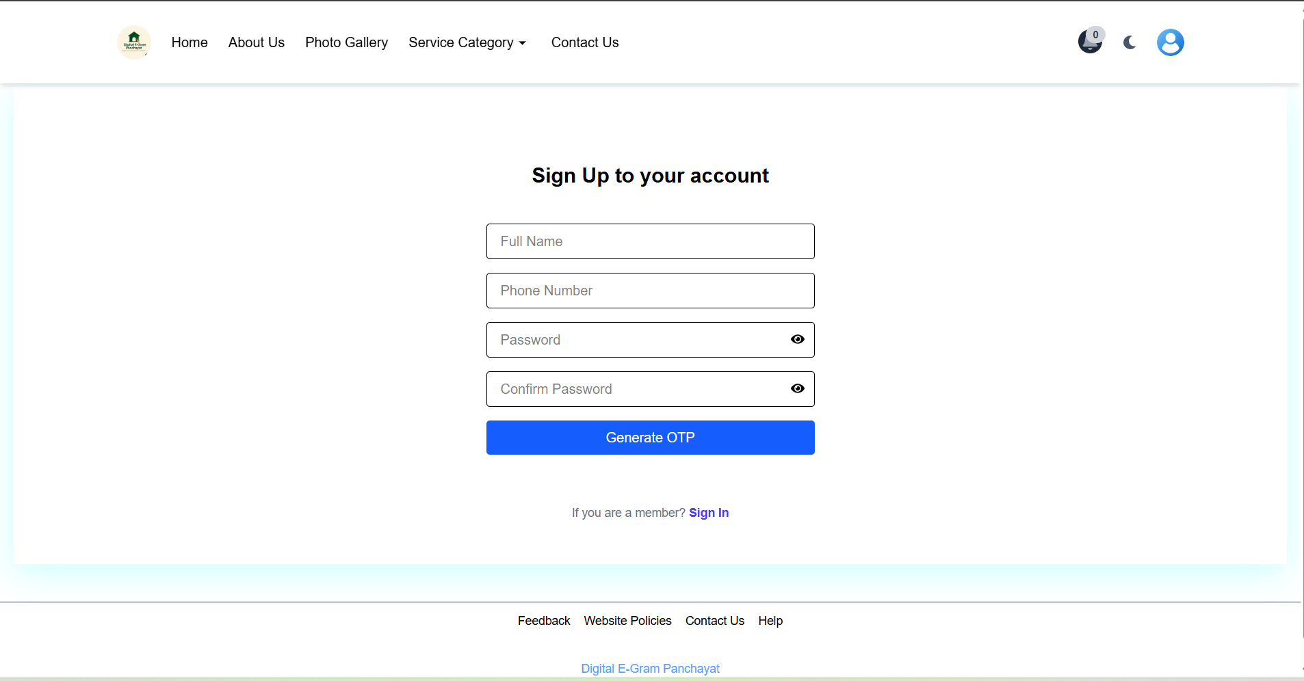
Secure User Registration
Signup process includes:
Name, Phone Number, and Password.
Password must be strong: 8+ characters, include uppercase, lowercase, number, and symbol.
This strong-password policy ensures data protection and account security for all users.
Prevents weak account setups.

Slide 25
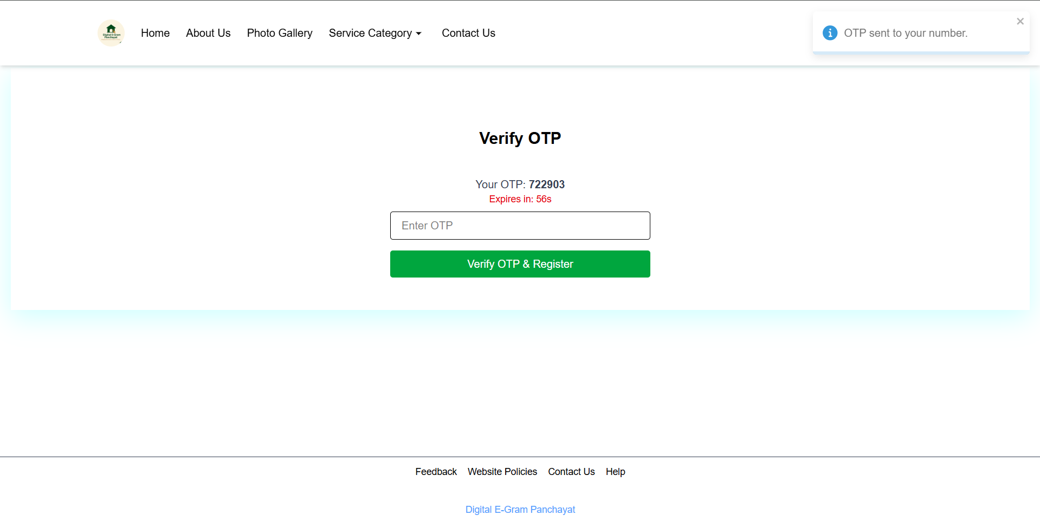
OTP Verification in signup
Sign in process:
Before Signing in, users are asked to enter a one-time password (OTP) sent or displayed on-screen.
Only after verifying the OTP, user can access the login form.
This two-step authentication reduces the chance of brute-force attacks or unauthorized access.

Slide 26
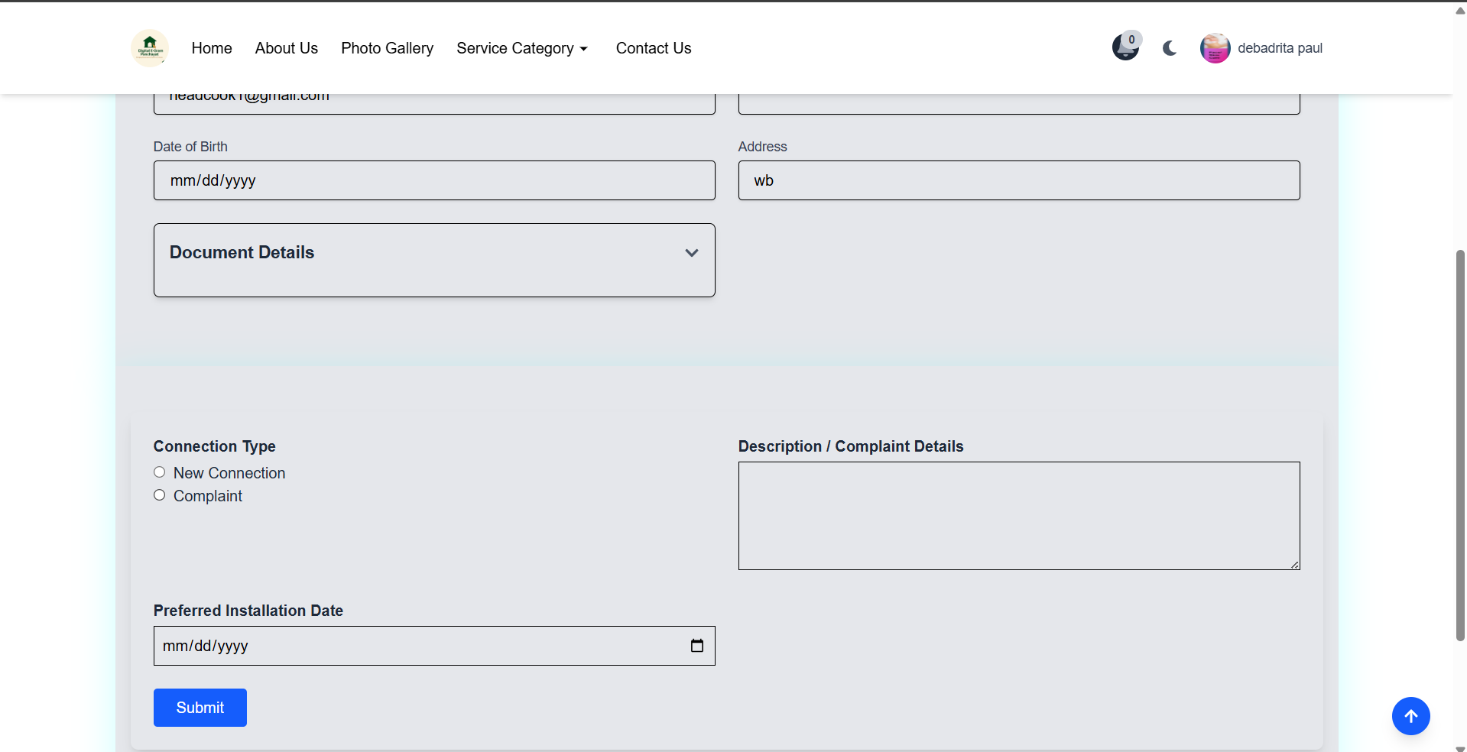
Post-Login Application Flow
Once logged in:
Users can fill out forms and apply for any service.
Each submission is stored under their account.
Application status can be tracked in real-time.

Slide 27
Rejection Reasons for Applications
When rejected, staff/officer/admin adds a reason.
If an application is rejected, the staff/officer must input a rejection cause. This cause is stored with the application and visible to the user when they click “View Reason” in the rejected applications tab. This builds transparency.
User can click “View Reason” in the rejected tab.
Modal opens showing the exact rejection note.

Slide 28
Profile Update Interface
The profile update page is a comprehensive interface allowing to manage their personal and identification details securely. The design ensures a clean layout with logically grouped fields to enhance user experience.
Users can input or update their full name, email address, gender, date of birth, and permanent address.
An image preview and upload section is provided for users to personalize their profiles. This photo is used in the navbar and profile sections.
The form supports multiple identification cards (e.g., Voter ID, Aadhar Card and Ration Card). Each entry contains:
A dropdown to select the type of ID
An input for the ID number
A file upload input for ID proof
Dynamic "+" and "–" buttons to add or remove ID fields as needed
The “Submit Profile” button finalizes updates and triggers a toast alert to notify the user of a successful update.

Slide 29
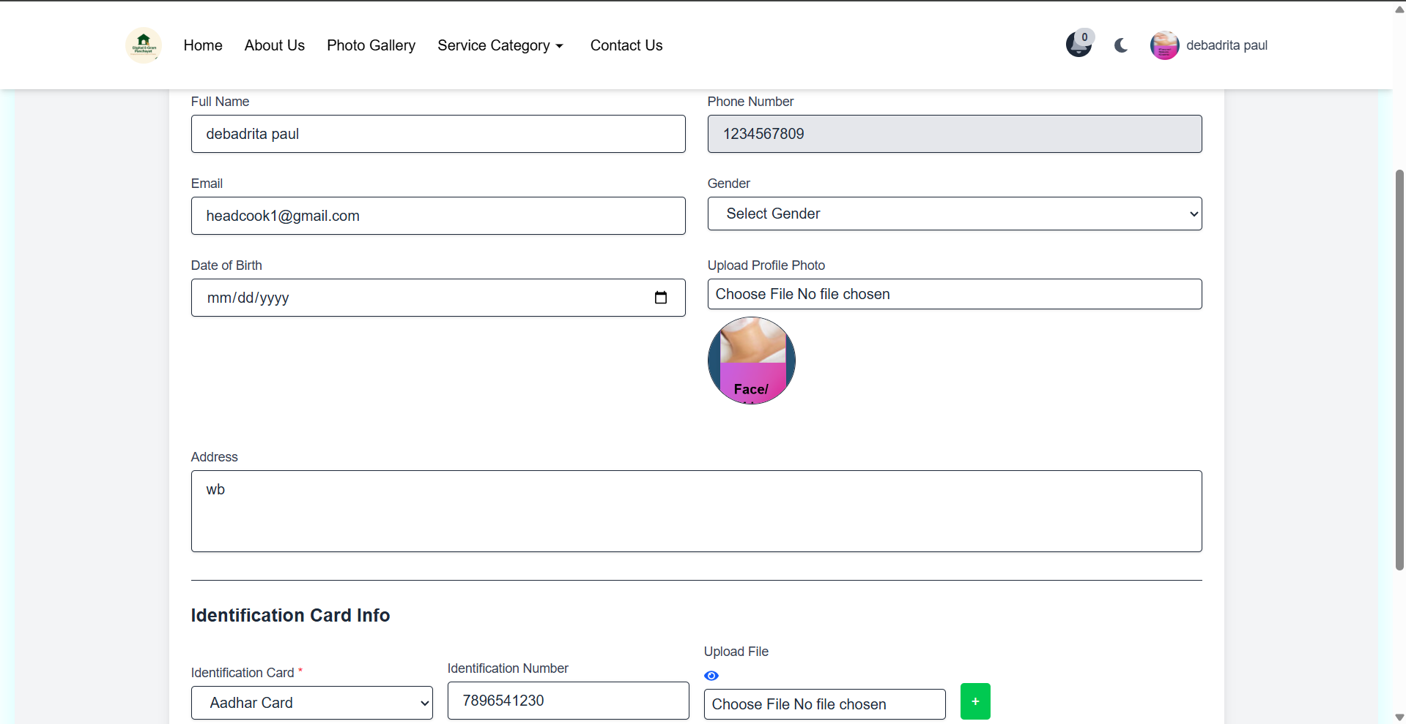
Profile Update Logic
Handles form submissions securely.
Uses FormData for uploading images/files
Axios for API requests
Toast notifications for feedback

Slide 30
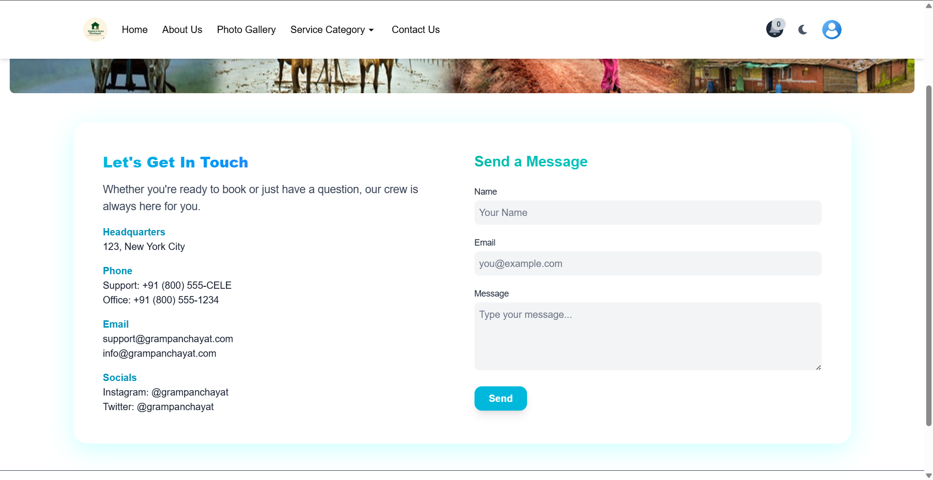
Contact Form for User Communication
Users can:
Submit queries or messages through the Contact Form.
Fields include Name, Email, and Message.
Admin can respond to or take action.
This helps citizens reach the Panchayat digitally without visiting the office.

Slide 31
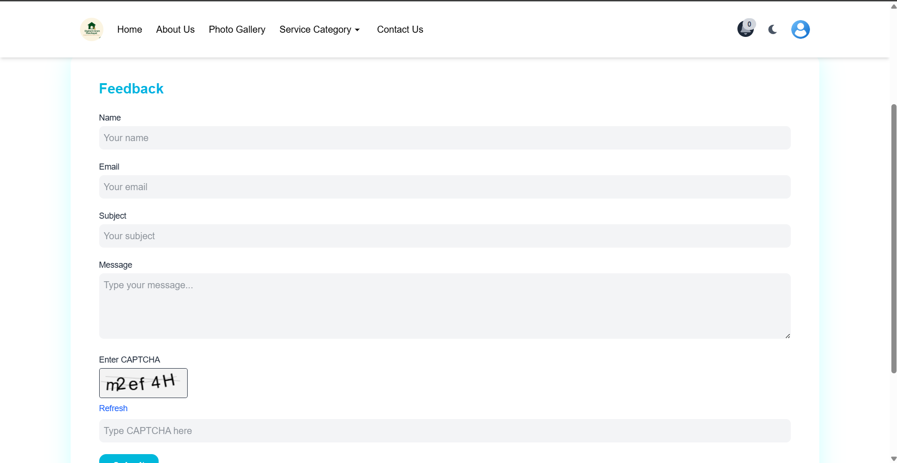
Feedback Form with Captcha
Feedback form includes:
Name, Email, Subject, Message.
Captcha integration to avoid spam.
Submitted data is stored securely.
Genuine feedback is valuable for improving the user experience and building trust between the public and administration.

Slide 32
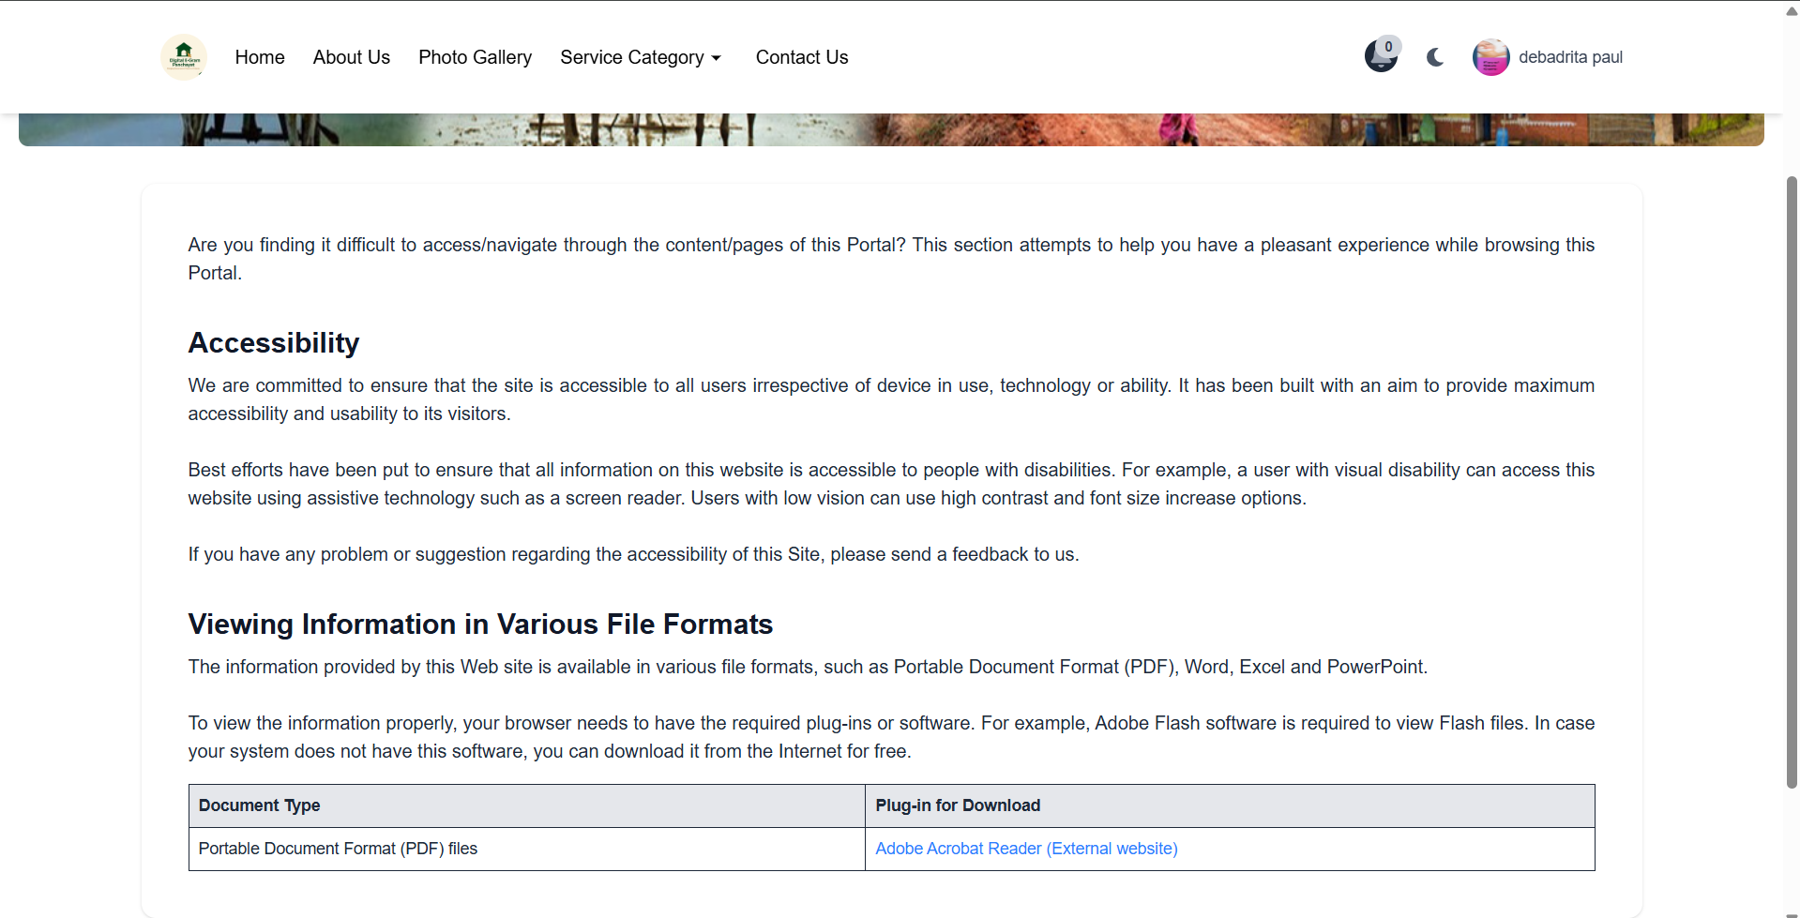
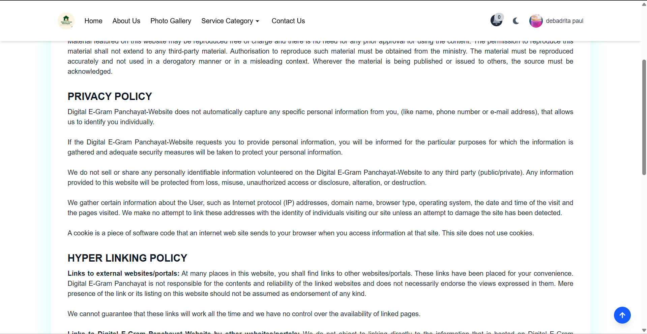
Static Content - About Us, Policy, Help
Users can read:
The platform includes static pages like “About Us”, “Website Policy”, and “Help”.
These are available to both logged-in and non-logged-in users.

Slide 33
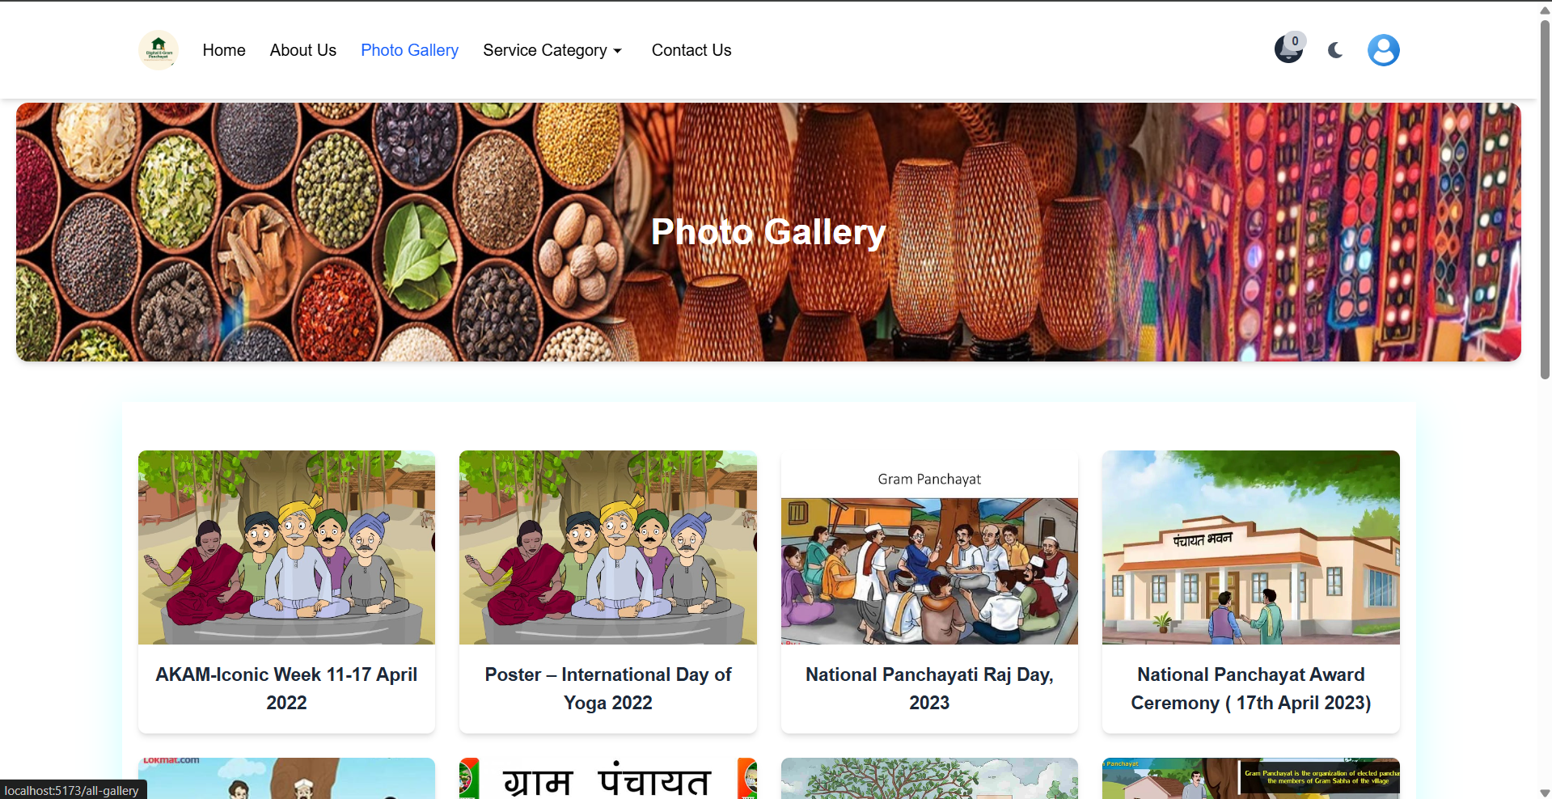
Gallery Modal Viewer
Gallery experience includes:
Users can explore galleries categorized by event or campaign
On clicking a gallery name, a modal opens with multiple images in a lightbox layout.
Modal opens with all images under that gallery.
Smooth, responsive layout for viewing.

Slide 34
Service Categorization
Users can:
Services are grouped by category and displayed in a clean, card-based interface.
Better organization and discoverability.
This categorization helps users easily locate services they are interested in, improving usability and interaction rates.

Slide 35
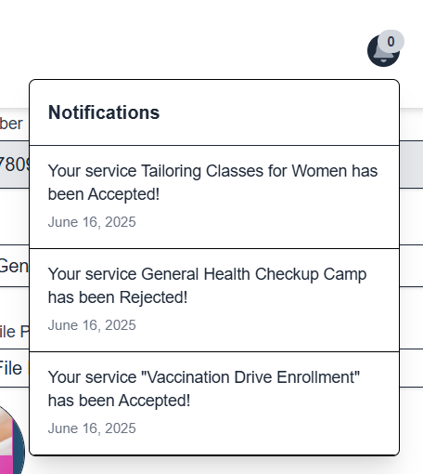
Notification System for Application Updates
Whenever application status changes:
User receives a notification.
Shows who made the change (Staff/Admin/Officer) and at what time/date.
All notifications are stored in a panel.

Slide 36
Notification Bell with Animation
If there's a new notification, the bell icon will animate/ring (e.g., shakes).
Draws user's attention without disturbing UX.
Clicking it opens the notification center.
This visual cue improves user awareness without being intrusive. Notifications can be marked as read.

Slide 37
Service Request Flow
How users submit and track services:
Submit applications digitally
Staff review and approval
Track status in dashboard

Slide 38
Security Features
Ensuring secure data exchange:
JWT-based authentication
Role-based UI access
Input validations

Slide 39
UI/UX Design
User-friendly and accessible UI:
Dark/Light mode toggle
Mobile responsive layout
Simple navigation

Slide 40
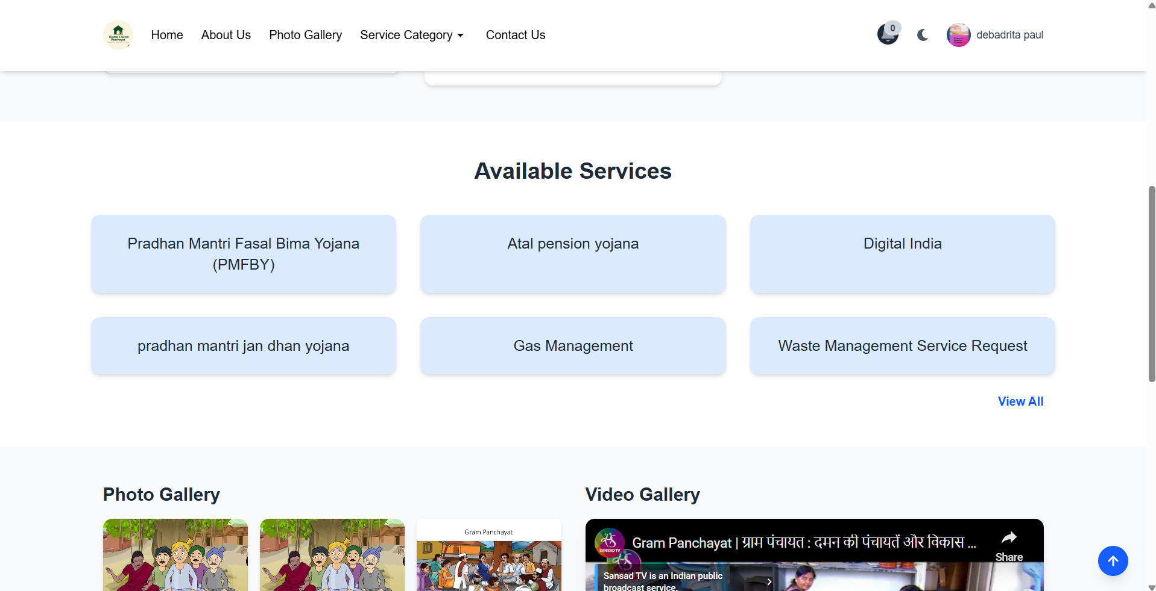
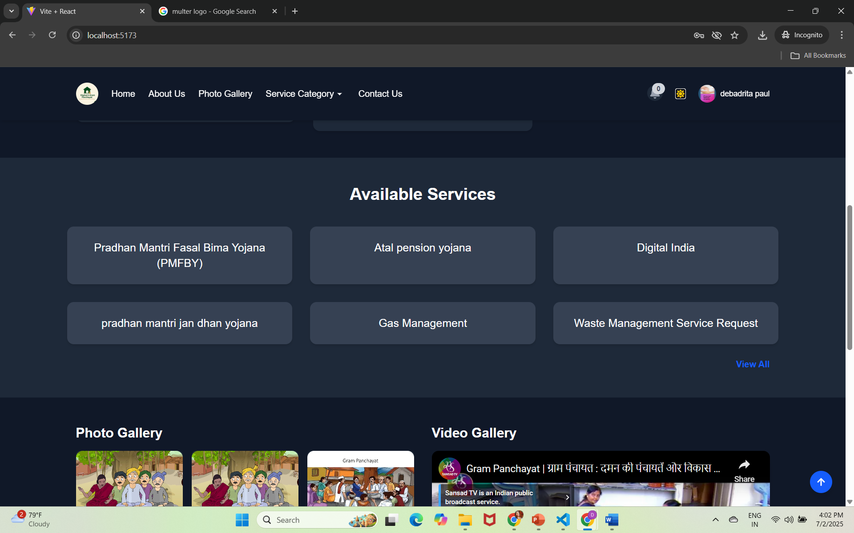
Dark/Light Mode Toggle
Users can choose between light or dark UI themes according to their comfort.
The toggle is accessible globally across pages and remembers the user’s last selection.
This feature improves accessibility for users with vision issues or those browsing at night.

Slide 41
Future Enhancements
Possible features to be added:
SMS Alerts
House-level village map

Slide 42
Conclusion
This project digitizes local governance, boosting transparency.
Full-featured web app built with MERN stack.
Modern UI, role-based security, transparency, accessibility, and digitization and fully responsive.
Compatible with mobile, tablet, and desktop devices.

Slide 43
Thank You
Digital E-Gram Panchayat
Empowering Villages with Digital Access
Visit our GitHub for full source code – Live Demo

